Slide 1
NMMS Education, Training and Networking
Updates and constituent feedback

Slide 2
NMMS Planning Priorities
Strengthen Small Business and Creative Economy development
Enhance Service Delivery to Respond to Community Needs
Align resources and project implementation supports
Restructure, strengthen education, training and networking activities
Strengthen coordination, communication and performance management.

Slide 3
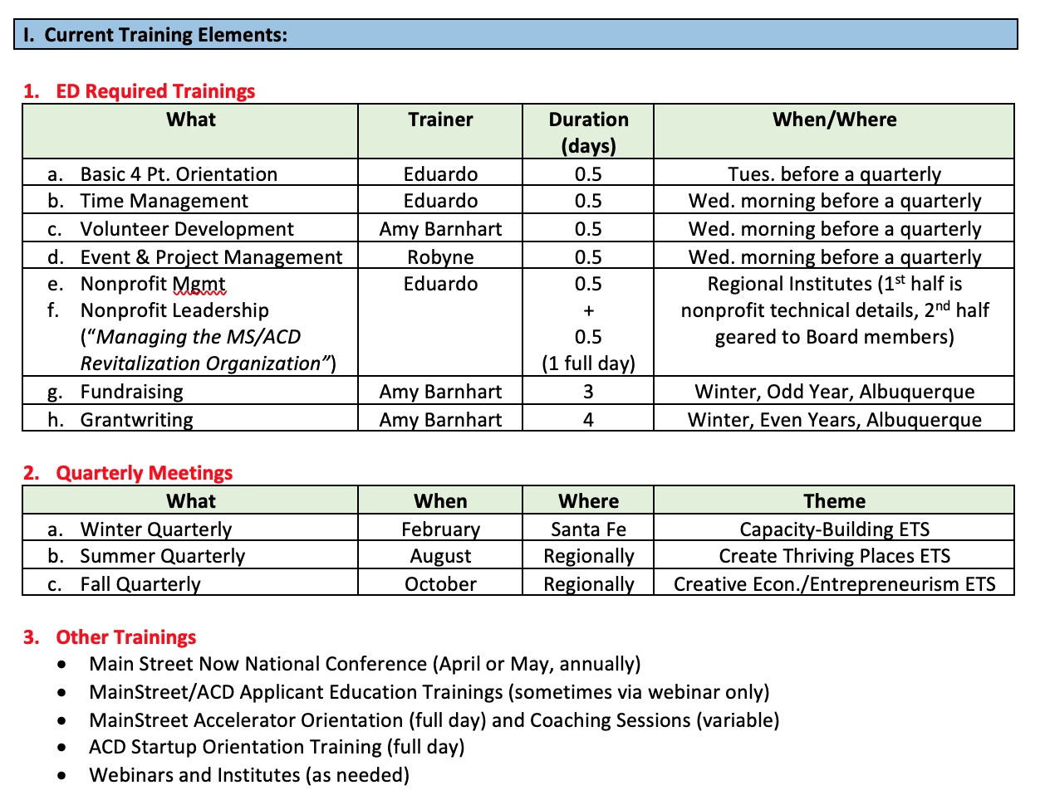

Slide 4
Changes in 2020
Build Capacity
Create Thriving Places
Enhance Small Business, Creative Economy
Eliminate Fall Quarterly Meetings, move to Winter Conference, Summer Institute
Eliminate the Wednesday morning sessions at the two convenings
Add a 3 to 3.5 day ‘Boot Camp’ for new ED’s: Integrate both Four Point and required training content
Require ACD representation at the Conference and Summer Institutes
Integrate new MainStreet America Std’s

Slide 5
Under Consideration
Regional Institutes – still needed?
How to incentivize board member participation?
Move the Board Development training to a service? Required?
Expand project management to a full day (or more)
‘Re-energize’ track for “stale” organizations
Implement Basic vs. advanced tracks
Complete Level I and II fundraising/grantwriting tracks annually

Slide 6
Building Capacity for Economic Vitality

Slide 7
Defining EV Capacity
The ability of an organization to do the Economic Vitality work - having the knowledge, skills, ability, connections and resources to implement Economic Vitality tasks
A willingness to dive into a project that seems impossible

Slide 8
Elements of EV Capacity
A “high-capacity” EV team is one willing to community organize, engage stakeholders, problem solve, educate community and property owners about available public finance tools, and then utilize those tools (or work with their local municipalities to use them).
Working to create an environment that is supportive, open and welcoming to local business, entrepreneurs and innovators, leverages local, cultural and historical assets to drive the local economy. The ED and some of the board should be comfortable with the concepts of economic and financial tools - capital, incentives, MR plans, bonds, incubators, lending strategies, etc. as well as property redevelopment that are appropriate to their community needs and resources.

Slide 9
QuickPut Assignment
Engage in brief discussion about the current capacity of your respective organizations to implement Economic Vitality tasks, as well as the Education, Training and Networking needs that should be addressed
Share ideas about what’s working, what needs additional development
Group discussion (assign a spokesperson)
30 minutes for discussion, 30 minutes for info sharing/discussion

Slide 10
EV Essential Questions
Based on what you heard this week, and the definitions provided earlier, what are some good examples of EV capacity?
In consideration of your own organizational assets (and challenges), how can you build capacity as previously defined? Focus on Solutions!
What assistance do you need from NMMS or others to advance your Economic Vitality work?

Slide 11
Education/Training Questions
What training topics do you need to move your work forward? (be specific, and consider all Four Points
What would you like to see/hear/experience at the Winter Conference? At the Summer Institute?
What education/training should be implemented locally?
What other suggestions do you have for NMMS?

Slide 12
Report Outs

