Slide 1
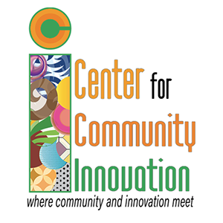
History & Mission
The Northeastern New Mexico Educational Foundation was incorporated in 1997 to provide higher educational opportunities to under-served adults in rural northeastern New Mexico. Between 1998 and 2008, The Center helped people obtain associates, bachelors, and master's degrees. In 2008, we gave our facility to Highlands University. Highlands left Raton in 2015.
The NENMEF is back in a whole new way as
The Center for Community Innovation
Fighting for Raton's economic future.

Slide 2
Services & Programs
As The Center began transitioning from a solely higher ed focus to an economic development focus they partnered with Raton MainStreet and New Mexico Mainstreet's Sean O'Shea to complete a feasibility study to help determine the needs of the community and what services should be offered to have the biggest community impact.
Truly knowing the needs of your community and having data (such as a feasibility study) to include in funding requests is important and often required to complete funding requests.

Slide 3
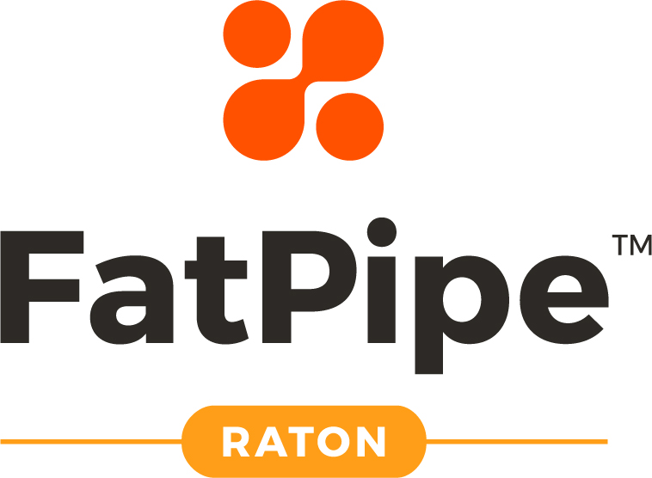
Services & Programs
Entreprenurial Training
In the past 24 months, The Center has completed 3 Entreprenurial Bootcamps that assisted 18 Entrepreneurs in developing their small businesses.
Funding Sources: Libraries as Launchpad Grant Recipient,
The City of Raton, The City of Trinidad, Creative Startups
The Center is home to FatPipe Raton, a Co-Working space that is a branch of FatPipe in ABQ. We offer coworking space and online class offerings available to FatPipe Tenants.
Funding Sources: LEDA Funds help with some costs (Hi Speed Internet), Local Fundraising & Tenants

Slide 4
Services & Programs
Funding Sources: The Center (local fundraising efforts), USDA Equipment Grant
Funding Sources: The New Mexico Economic Development Department funds job creation

