Slide 1
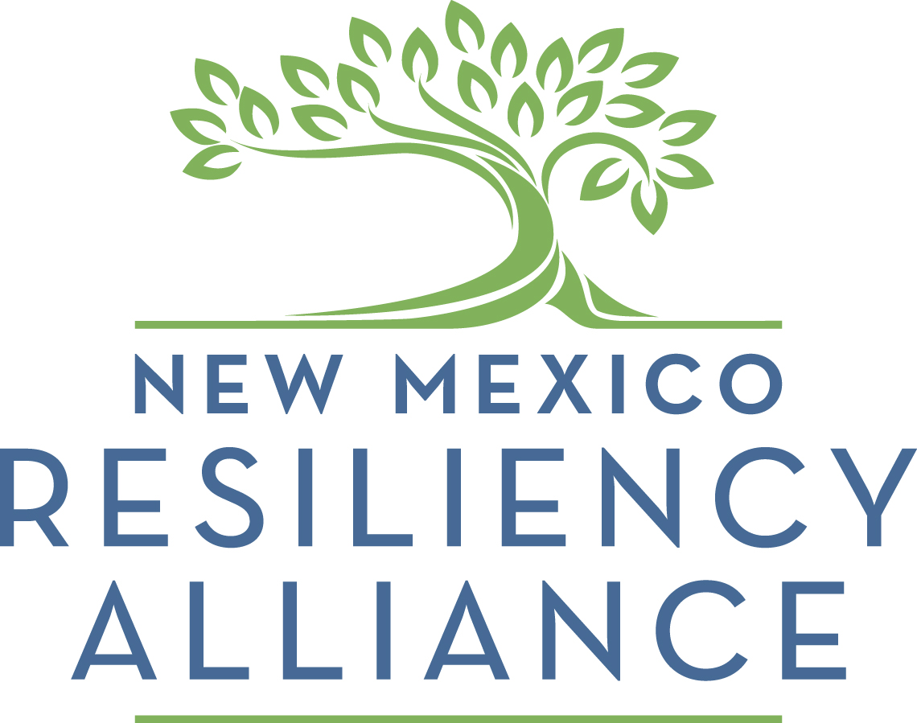
Economic Vitality Funding
Funders perspective

Slide 2
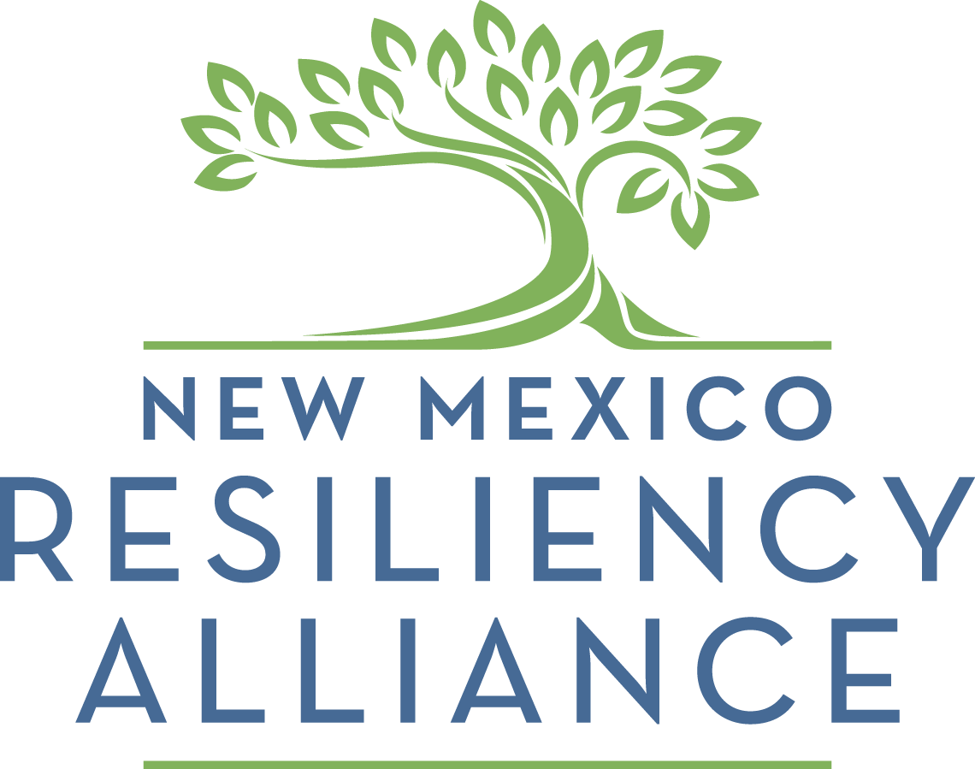
About NMRA
Mission: To strengthen the resiliency of New Mexico’s rural and underserved communities by mobilizing and leveraging resources and collaborative partnerships that enhance the economic vibrancy and quality of life of its residents.
Resilient Communities: Have awareness of their strengths and a high capacity to utilize those assets to build community while adapting to changing socio-economic conditions in order to sustain economic activity, social connectivity, and quality of life.
Resilient Communities Fund: provides financial support for locally-driven, community-based economic development projects statewide.

Slide 3
Our Funding Partner
Strategies for Rural Development: Initiatives that revitalize the most sustainable and traditional practices in creative ways and upgrade rural built environments in terms of revitalization and community cohesiveness/connectivity.
Economic Development: Expand the economic base by fostering entrepreneurship across sectors, provide training and technical assistance to entrepreneurs.
Influencing Built Environments: Inject community voice into development, use innovative approaches to planning, design and construction, affordable housing.
Capacity-Building in the Nonprofit Sector: Engage diversity, develop leadership, access expertise, professional development and training that builds capacity.
Linking Arts and Community Engagement: arts as a tool for civic engagement, collaboration-building, reaching diverse audiences, and economic revitalization.

Slide 4
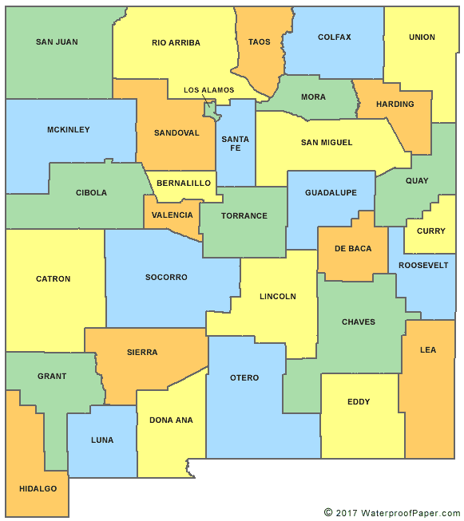
RCF Grants - $311,000 since 2014
$25.9k
8%
$28k
9%
$40.5k
13%
$201.6k
65%
$15k
5%
Promo Org EV* D/P Design
9 8 11 2 52
* Includes 2 non-NMMS affiliates
1 2 3 4

Slide 5
EV Funded Projects
Generation Ag Youth Entrepreneurism (Mora, 2015, $3k)
Drylands Brewpub Business Plan (Lovington, 2015, $5k)
Business Development Workshop (Farmington, 2015, $1k)
Calle Cuarta Incubator Business Development (Barelas, 2016, $5k)
Coworking Space Development (Los Alamos, 2016, $5K)
Youth Farm to Market Entrepreneurism Development (Villanueva, 2016, $5k)
Downtown Business Succession Workshops (Gallup, 2017, $4k)
Community Economic Development Plan (South Valley, 2017, $4k)
High Five! Business Development Funding (Alamogordo, 2019, $2.5k)
Community Supported Agriculture Development (S. Valley, 2017, $3k)*
Youth Entrepreneurship/Food Handler Trainings (Silver City, 2017, $3k)*
* non-NMMS affiliate

Slide 6
Requirements
Must be Legally-Compliant 501c3
Meet Eligibility Criteria
Align with the Funder(s) Mission and Goals
Economic Development, Underserved Communities, Revitalization, Capacity-Building
Complete Projects by Deadlines
Spend Funds for Intended Uses
Comply with Other Grant Terms and Conditions
Comply with and report leverage/match commitments

Slide 7
What We Hope For...
Plan Ahead: Apply only when ready; seek RS assistance early, submit on time
Clearly-articulated proposals with clear goals, tasks to be completed, economic impacts, and intended use of funds
More/Stronger EV Projects, or those with demonstrated EV impact
Follow-through on EV and Capacity-Building impact measures (public art, placemaking and promotions)
Project Durability: Business closures or Org. challenges water down impact of facade squads, challenge grants
More Historic Building Preservation/Adaptive Reuse, Cultural Preservation projects
Strengthen Community Engagement, participation (including diverse populations that reflect your community/district)

