Slide 1
Mainstreet Truth or ConSequences
Economic Vitality Funding

Slide 2
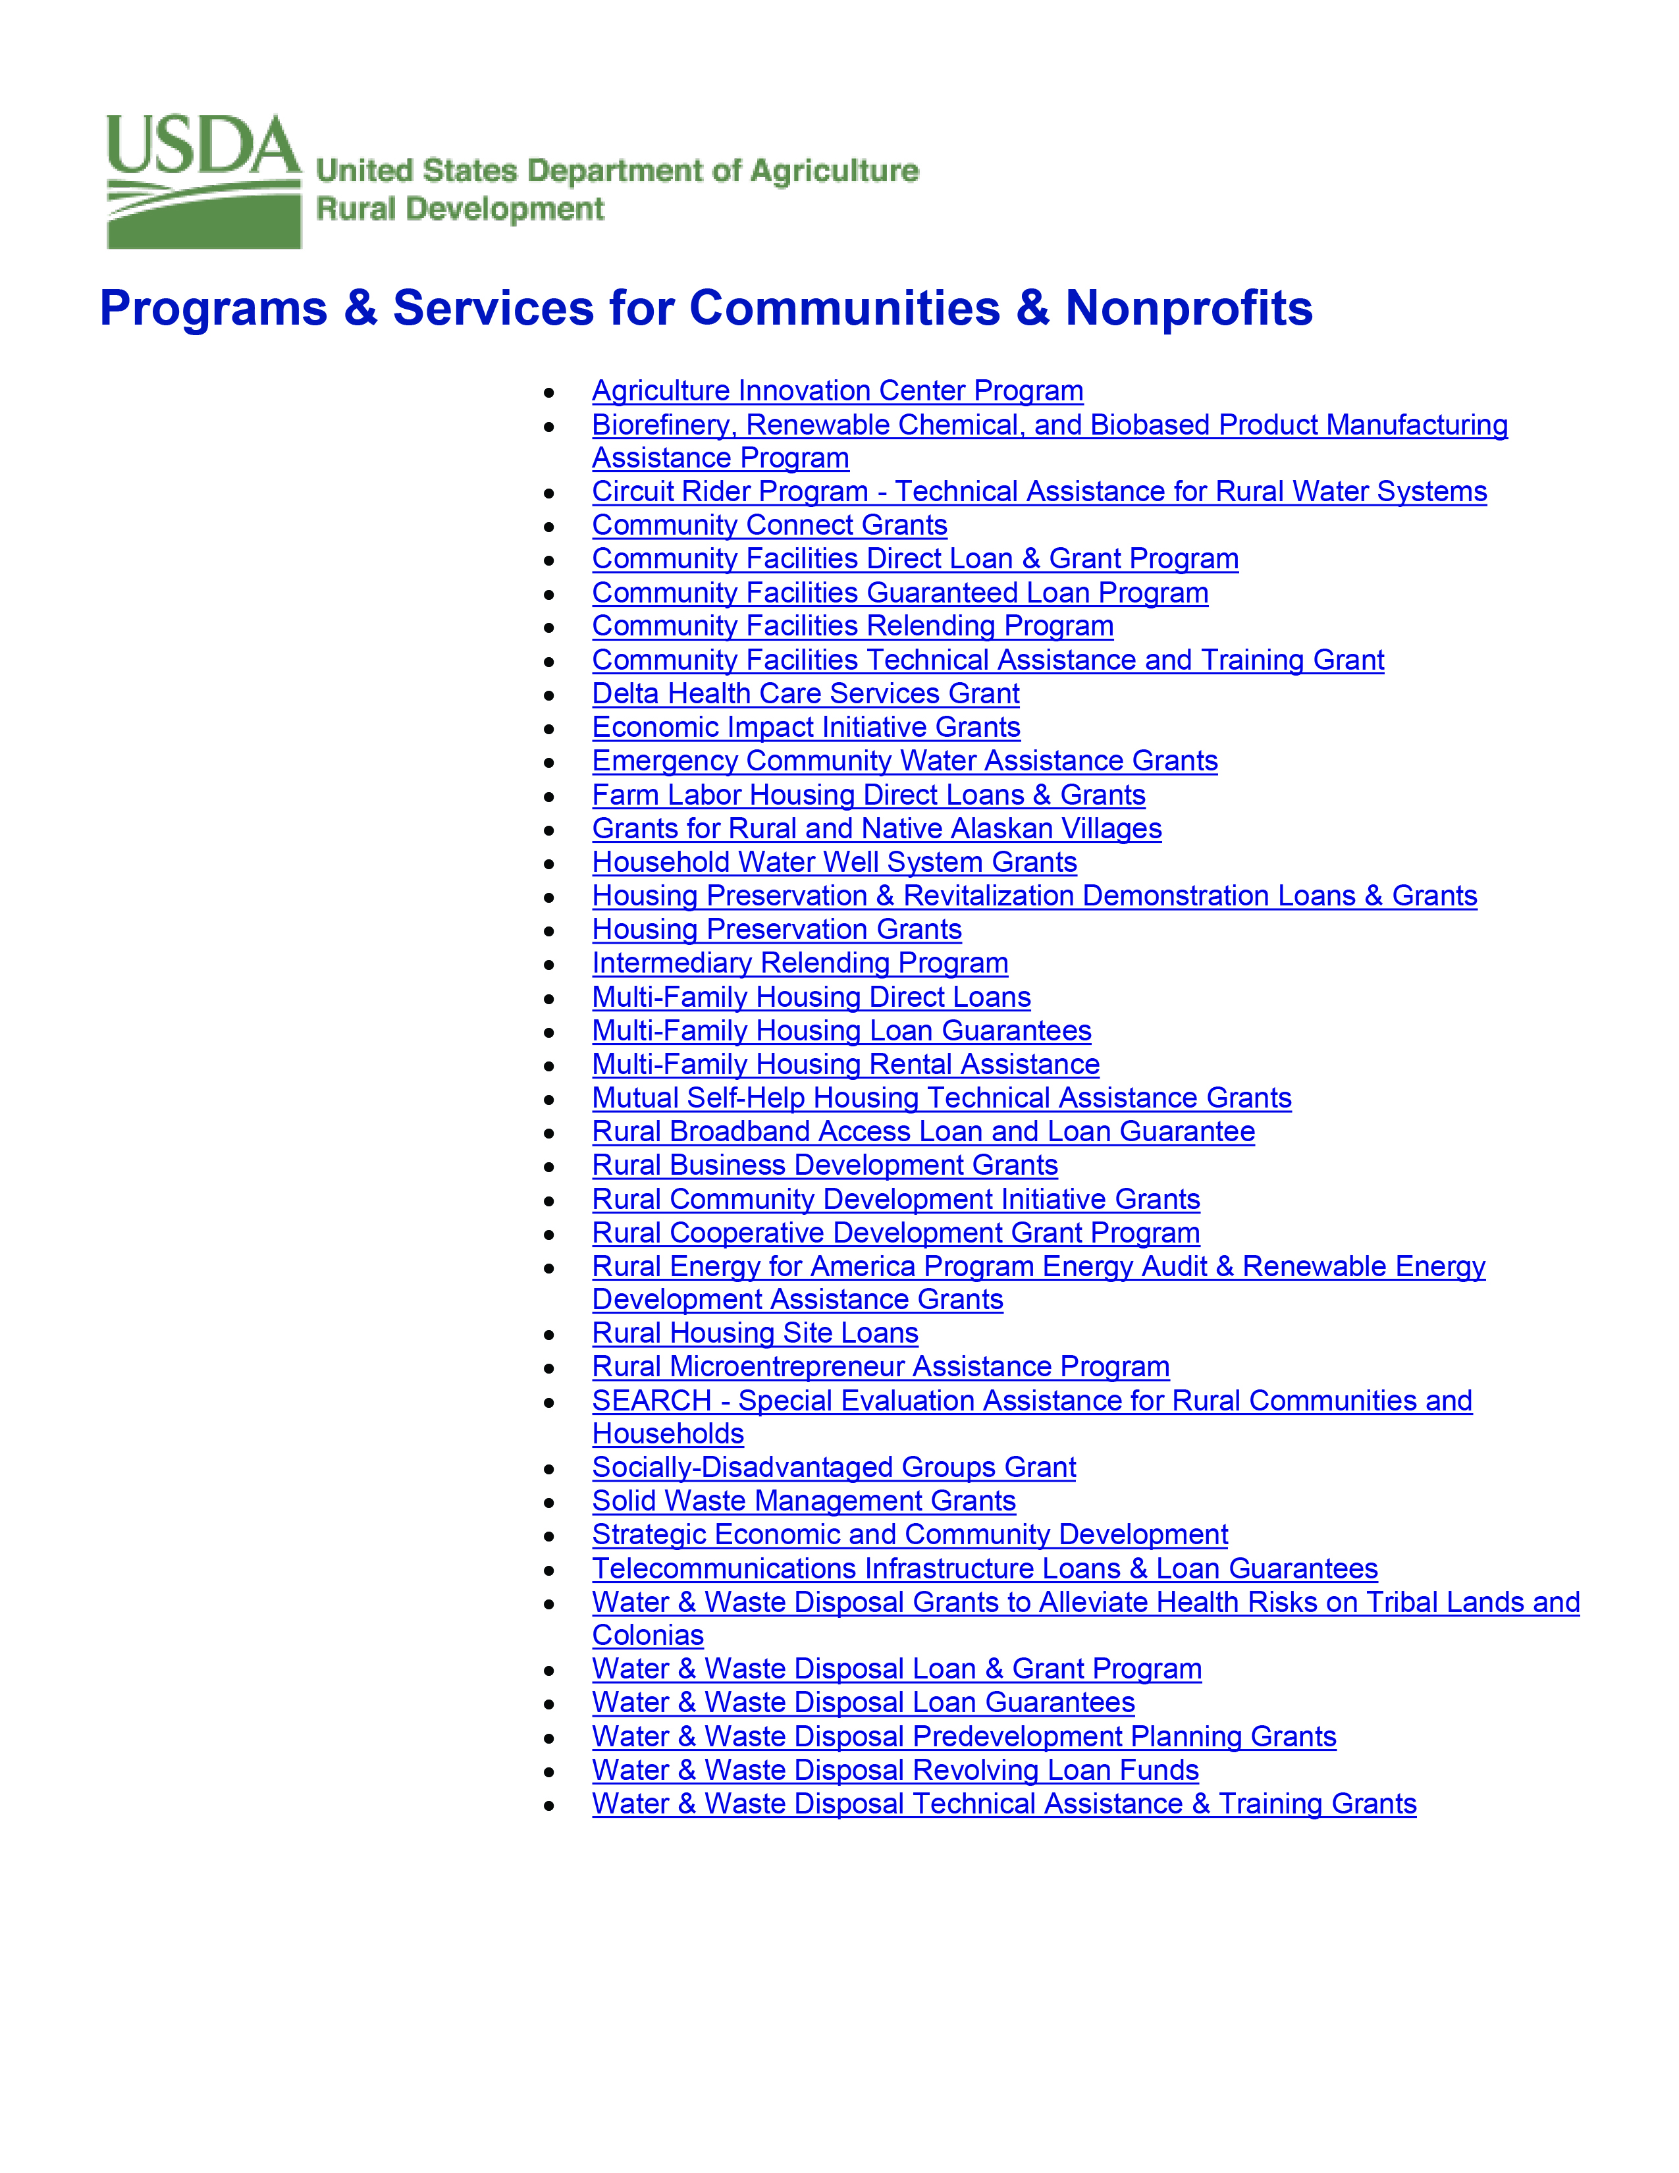
Rural Business Development Grant
$45,192

Slide 3
Program
Two parts- Speakers/ Business Resource Center
Questionnaire, Identified Speakers
Set up Resource Center
Speakers- Business Breakfasts or Training

Slide 5
Rural Business Development Grant
$28,971

Slide 6
